Slide 1
Capstone Project
Play Store App Review Analysis
By Afridi Pathan

Slide 2
Points For Discussion
Objective of project
Data summery
TOP 20 Apps according to Genres
TOP 20 Genres according to Installs
Average rating
Size is impacting no of Installs
Histogram of size
CORRELATION Play store

Slide 3
Objective of project
The objective of this project to deliver insight and better understand user and developer through the many data operation and understand better customer demands to populrize the Applications

Slide 4
Data summery
Problem Statement : The Google Play Store is the largest app market in the world.it generates more than double the downloads of the Apple App Store but markets only half of the money as the Apple Stores. Explore and analyze the data to discover the key factor responsible for app engagement and success.
There are tow data frame
Play _Store - This data frame is having a shape (10841,13). it holdsthe 13 features(Column) which include App, Category, Rating, Reviews, Size, Installs, Type, Price, Content Rating, Genres, Last Updated, Current ver, Android ver and implemented in order to take better business discussion.
User review - This data frame is having a shape (64295,13). it holds the 5 features(Column) which include App, Translated_Review, Sentiment, Sentiment_Polarity, Sentiment_Subjectivity
Merge data – As the name suggest, this data frame is the result of merging above tow dataframe based on feature app. As app is the only feature is common between thes tow data frame. merge data encapsulate all the feature from play store data and user review data frame.

Slide 5
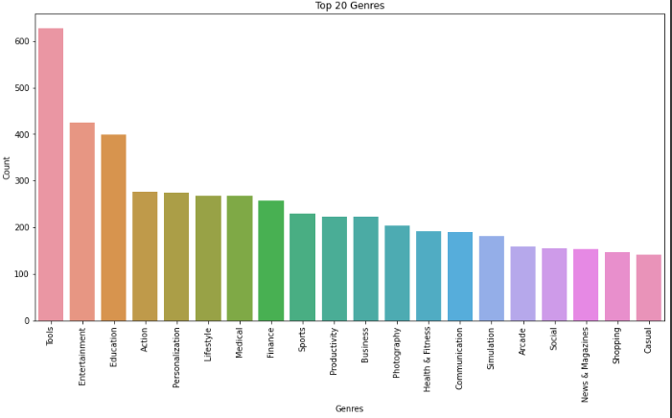
TOP 20 Apps according to Genres

Slide 6
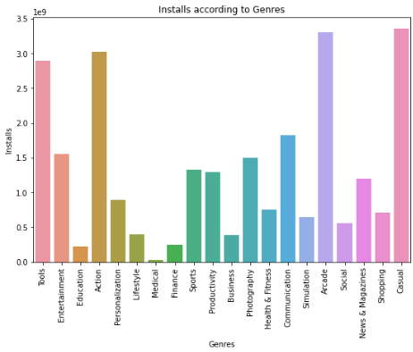
TOP 20 Genres according to Installs
Maxinum number of apps present in google
play store comes under Tools,Entertainment
and Education Genres but as per the installation
and requirement in the market plot, scenario
is not the same.Maximum installed apps comes
under Communication, Tools and Productivity
Genres.

Slide 7
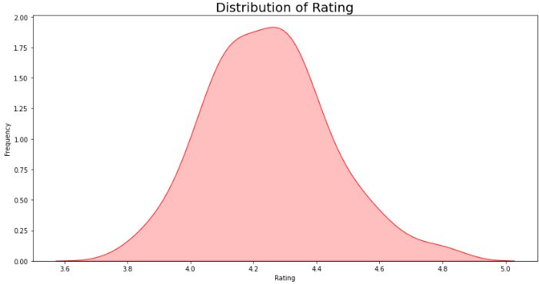
Average rating
Most of the rating is in between 4.0 to
4.5 There are very few applications
which got rating 5.0

Slide 8
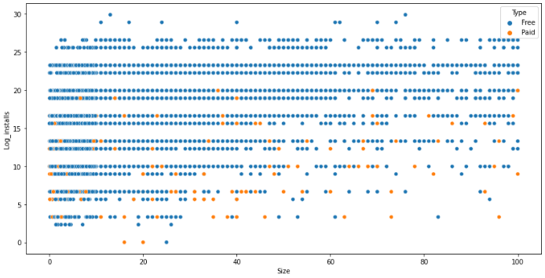
Size is impacting no of Installs
it is clear from the above mentioned plot that size may impact the number of installations. Bulky applications are less installed by the user.

Slide 9
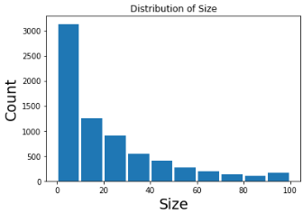
Histogram of size
it can be concluded that maximum number of applications present in the dataset are of small size.

Slide 10
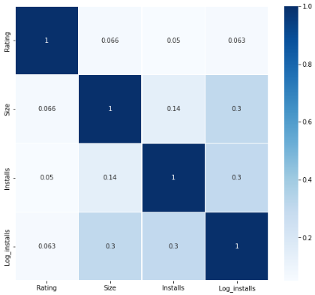
CORRELATION Play store
Their are install and Size highly pos correlated
data

Slide 11
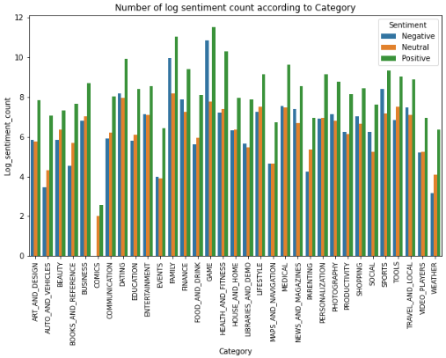
What is the distribution of type of reviews in the dataset
Majority of the genres have high positive sentiments, when compared to neutral and negative ones.

Slide 12
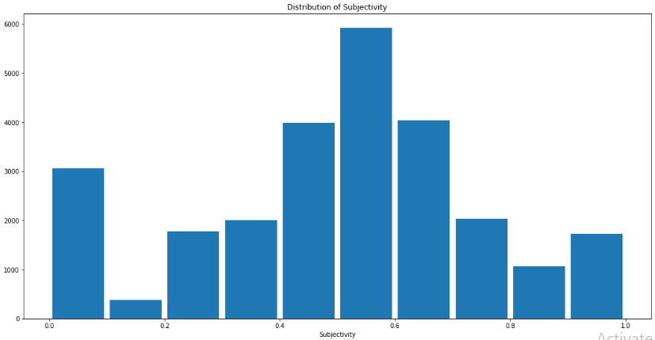
Histogram of subjectivity
It can be seen that maximum number of sentiment subjectivity lies between 0.4 to 0.7. From this we can conclude that maximum number of users give reviews to the applications, according to their experience.

Slide 13
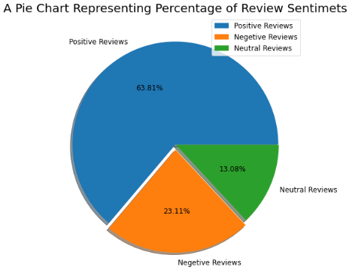
Percentage of Review Sentimets
Positive reviews are 64.30%
Negative reviews are 22.80%
Neutral reviews are 12.90%

Slide 14
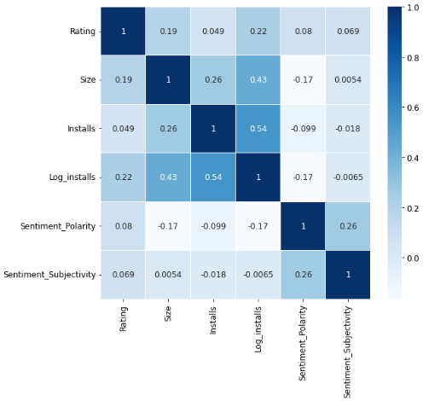
Correlation merged data frame
We can determine from above that each column are Positively Correlated.

Slide 15
Conclusion
Maximum number of sentiment subjectivity lies between 0.4 to 0.7. From this we can conclude that maximum number of users give reviews to the applications, according to their experience.
install and rating highly positive correlated data
Most of the rating is in between 4.0 to 4.5
In merge tow data frame We can determine from above that each column are Positively Correlated.
Majority of the genres have high positive sentiments, when compared to neutral and negative ones.
Size of maximum number of applications present in the dataset
Size is impact the number of installations

